Slide 1


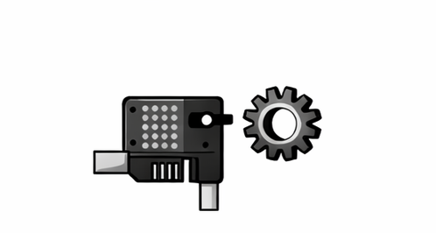
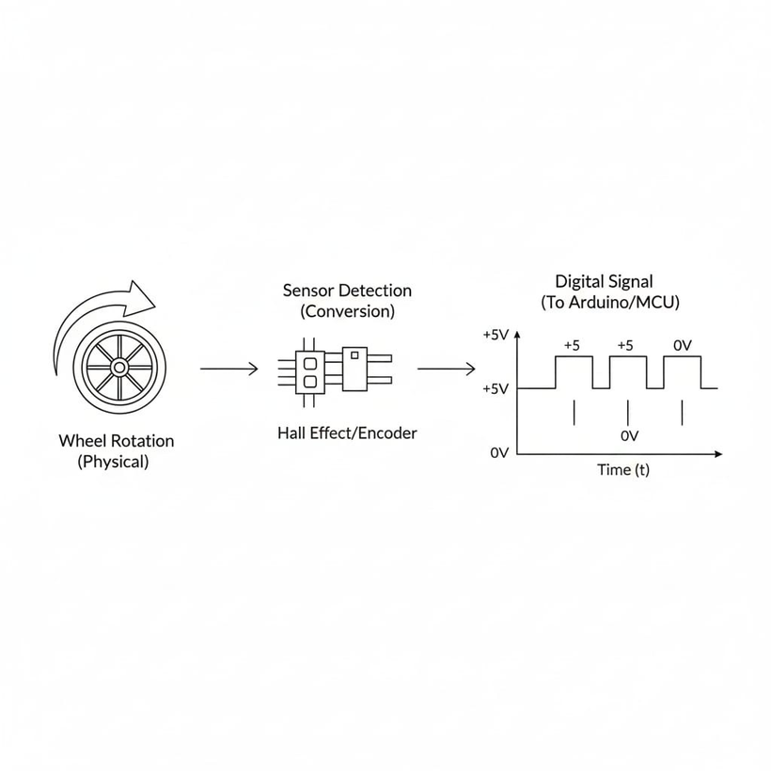

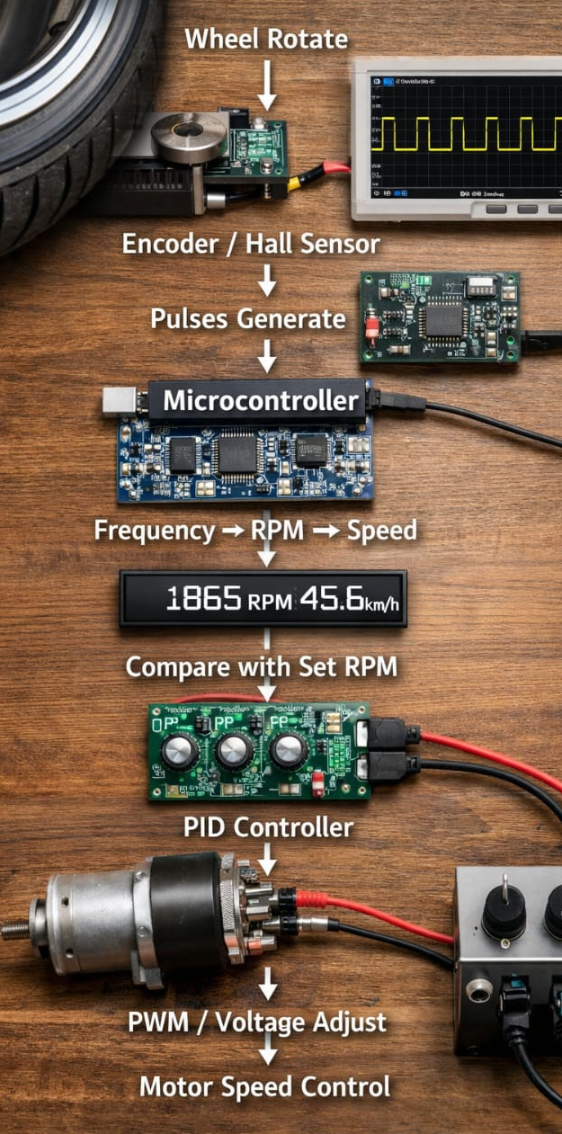
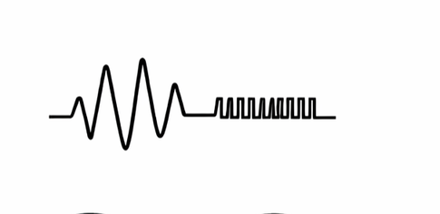


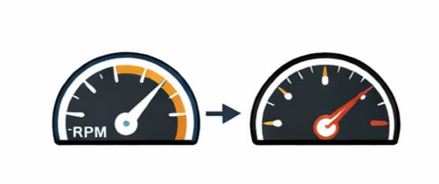

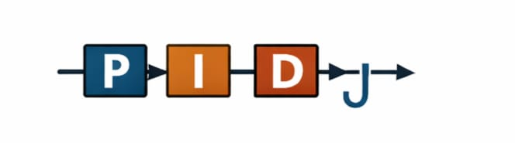
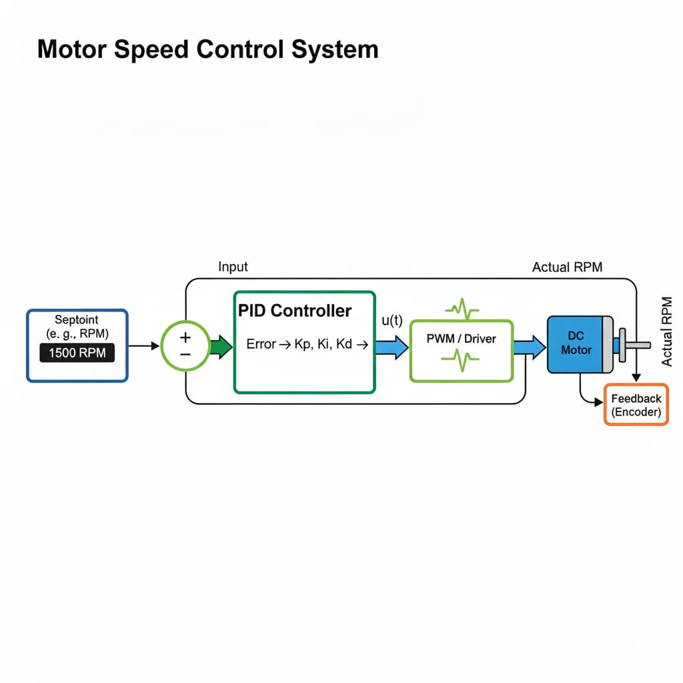

Wheel rotate
(Meachanical motion)
Encoder /
Hall Sensor
(Rotation Detect)
Pulses generate
(digital ON-OFF Pulse)
Microcontroller
(Pulse Count and Process)
Frequency → RPM → Speed
(Speed Calculation)
Compare with Set RPM
(error genration)
PID Controller
(P+I+D Control)
PWM / Voltage adjust
Motor speed control

